Slide 1
Experience-based learning as a class
TESL NS Spring Conference - May 2017

Slide 2
What is LEA?
“LEA” is the Language Experience Approach
Started in the 1960’s
Uses the life experience of learners as a basis of language learning: relevant, student-centered, and level appropriate

Slide 3
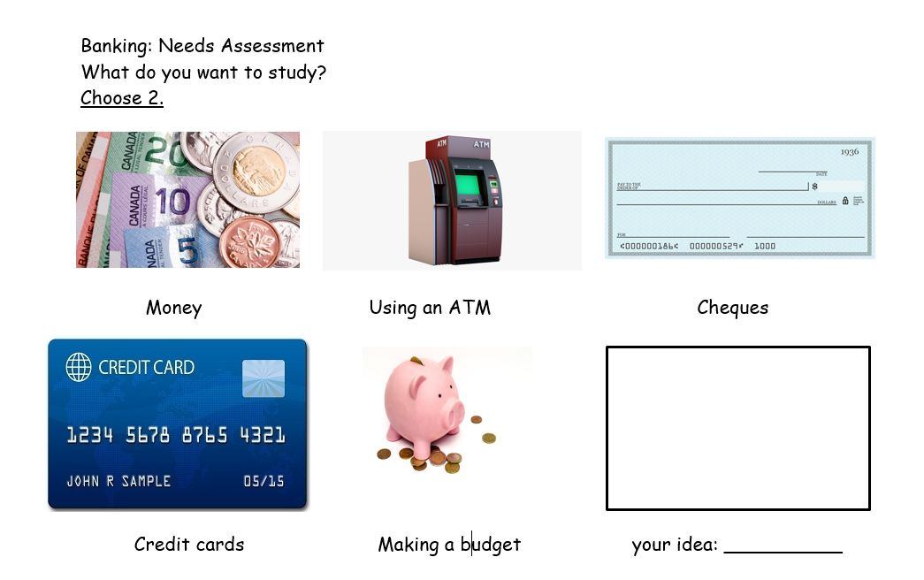
Needs assessment

Slide 4

Story

Slide 5
Learner-identified goals
Be able to use an ATM
Withdraw money
Deposit money
Transfer money between accounts
S and L: Giving instructions
(II: Comprehending/Giving instructions)
R: Reading the screens
(III: Getting things done)
W: Copying information into the machine
(II: Reproducing information)
CLB competency
statements

Slide 6
Assessment
Feedback from learners

Slide 7
Class library and self-directed reading report

Slide 8
Benefits of the experience-based approach
Learner-centered and relevant – Learners choose
Encourages learner autonomy – Learners go out into the community and accomplish goals
Task-based – Language studied arises from doing concrete tasks
Community integration – Learners see the community and the community sees them
Level appropriate – Customized for the level of the learners

Slide 9
Thank you for listening!
Anthony Caldwell
EAL Instructor
acaldwell@isans.ca

